Slide 1
Project report
AID – Group 23
2020 / 2021
Daniel Pereira (89425) & Rodrigo Sousa (89535)

Slide 2
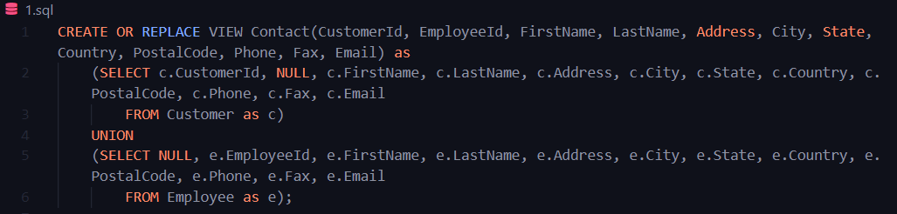
Challenge 1.

Slide 3
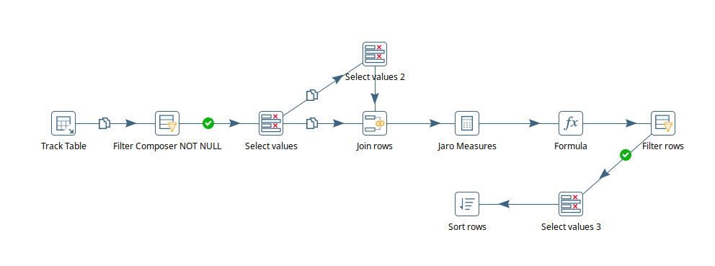
Challenge 2.

Slide 4
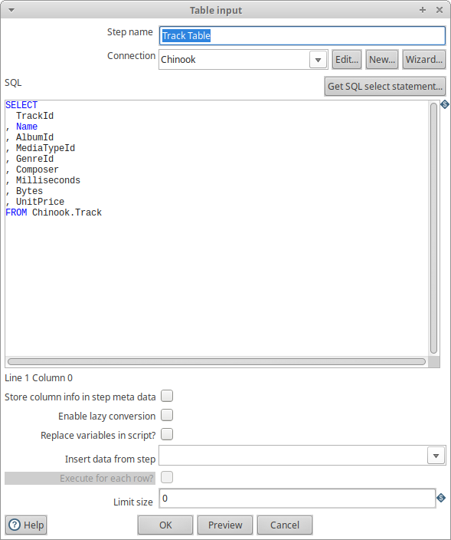
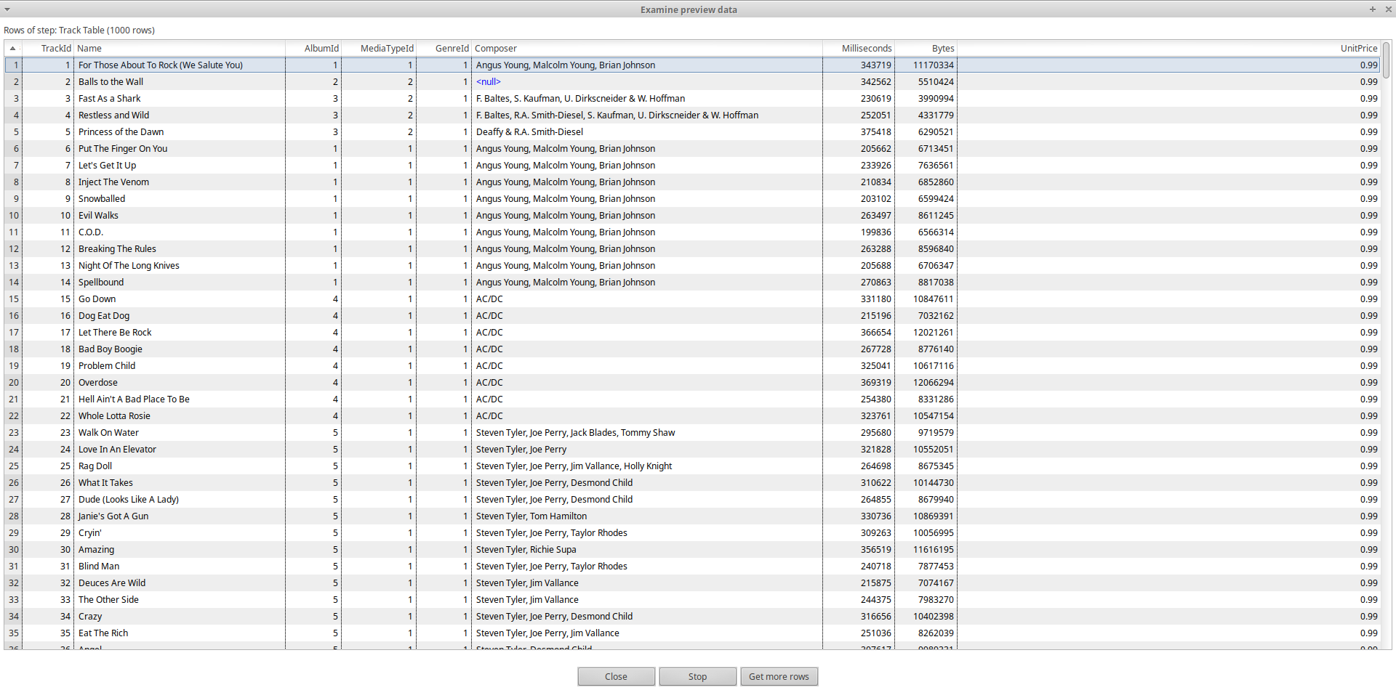
Table Input (Track Table)

Slide 5
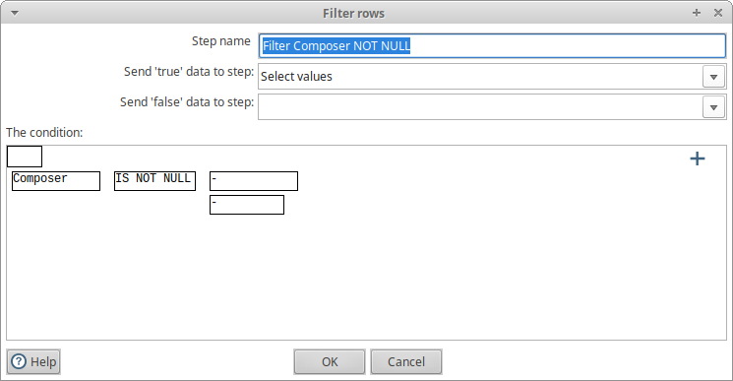
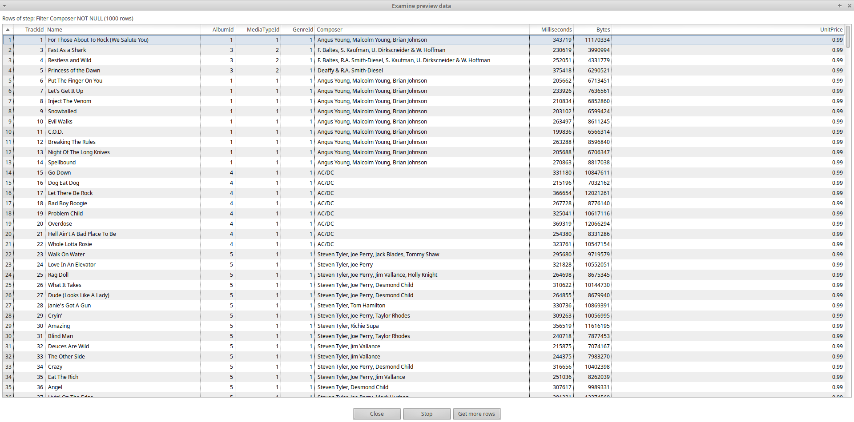
Filter Rows (Filter Composer NOT NULL)

Slide 6
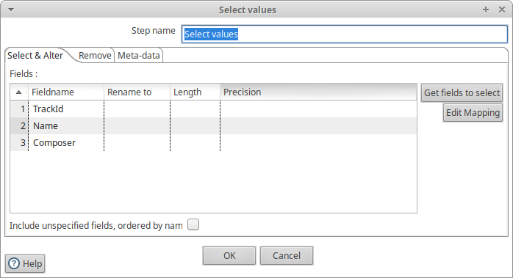
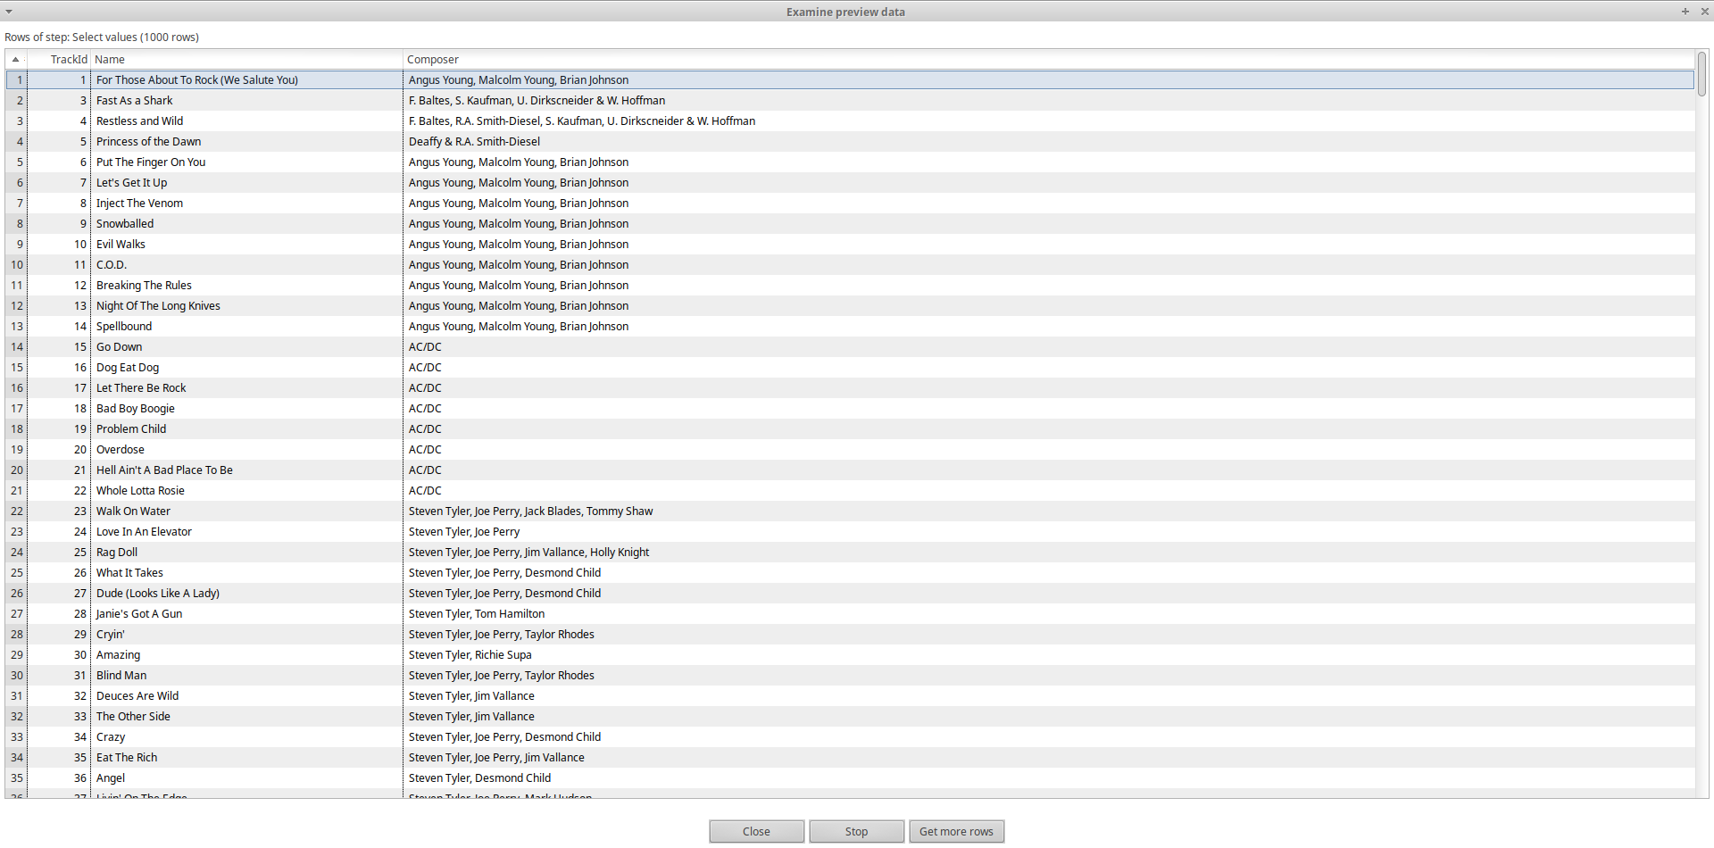
Select Values

Slide 7
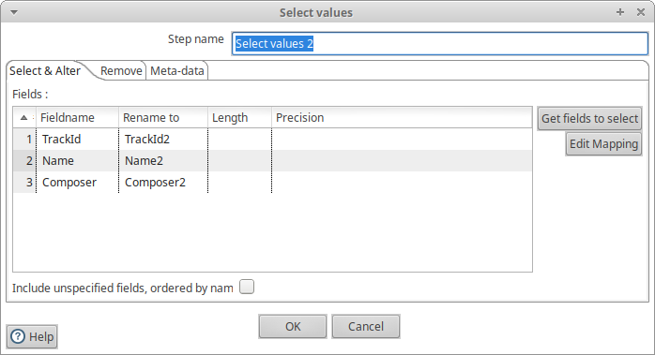
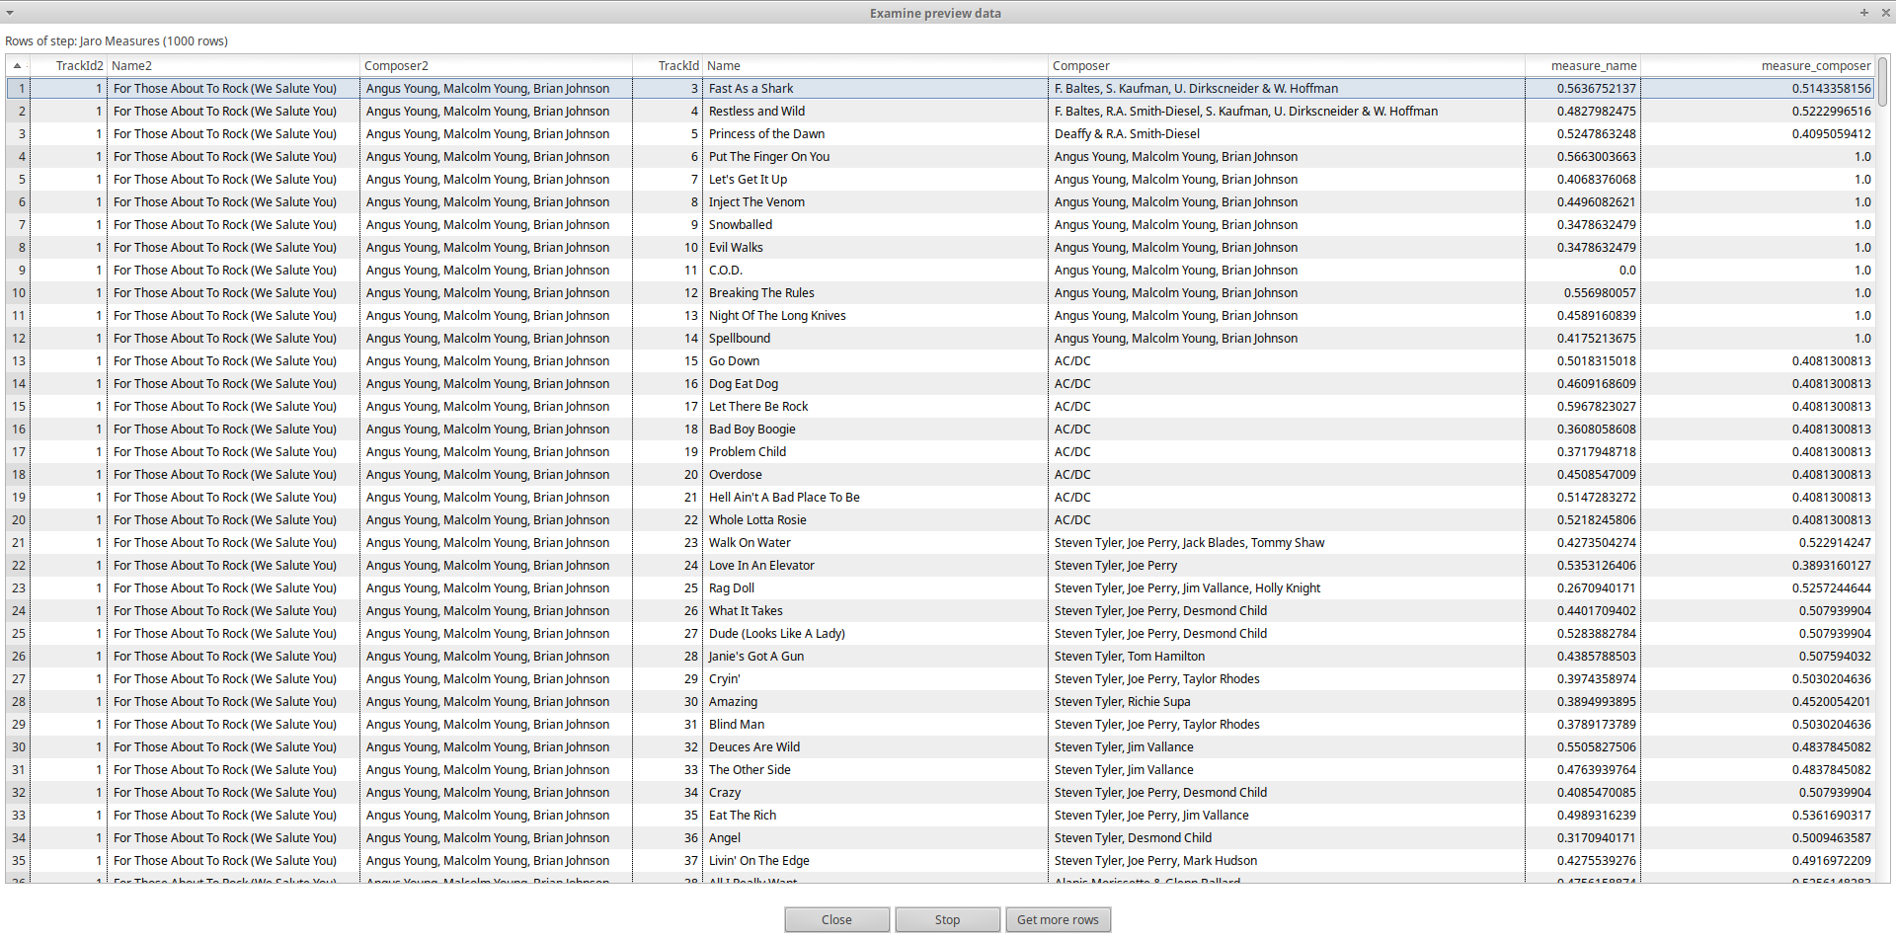
Select values (select values 2)

Slide 8
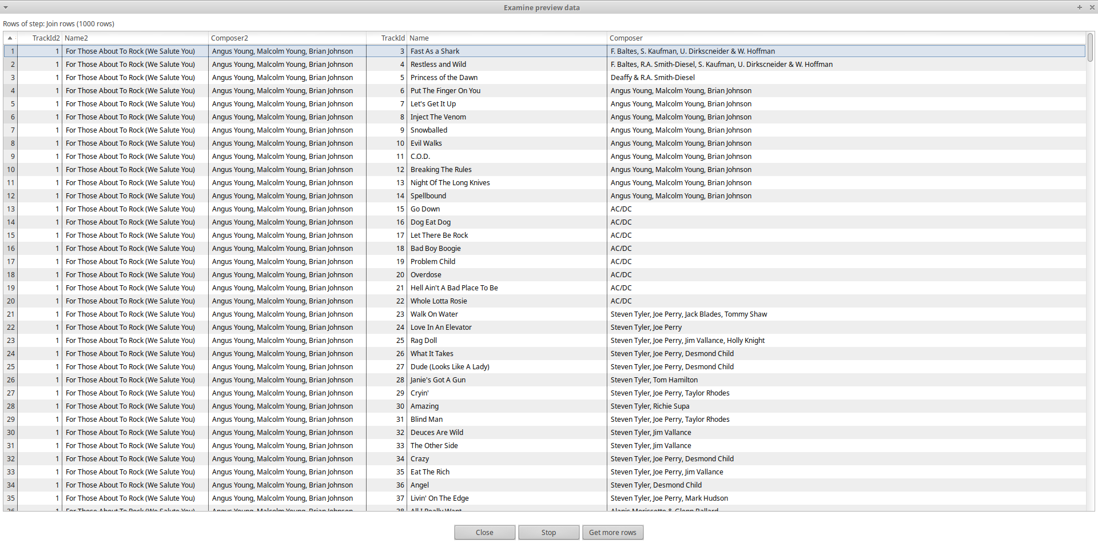
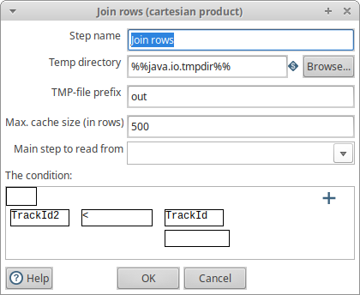
Join Rows (cartesian product)

Slide 9
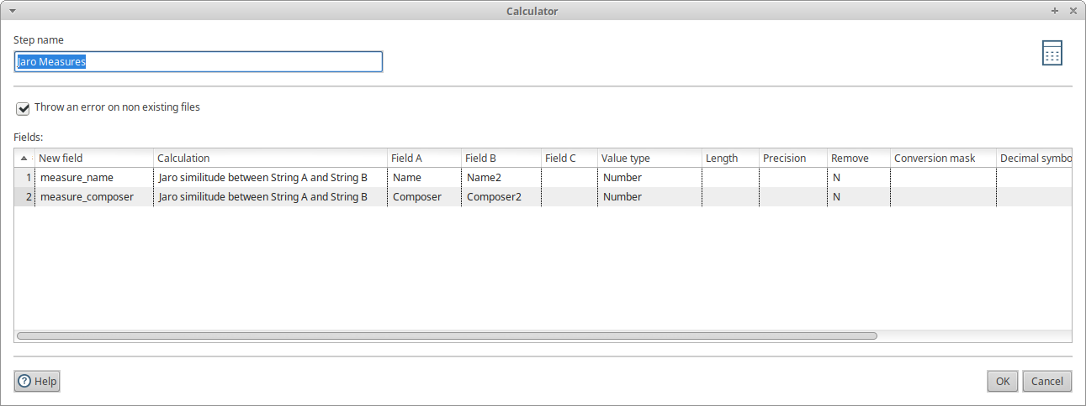
Calculator (Jaro measure)

Slide 10
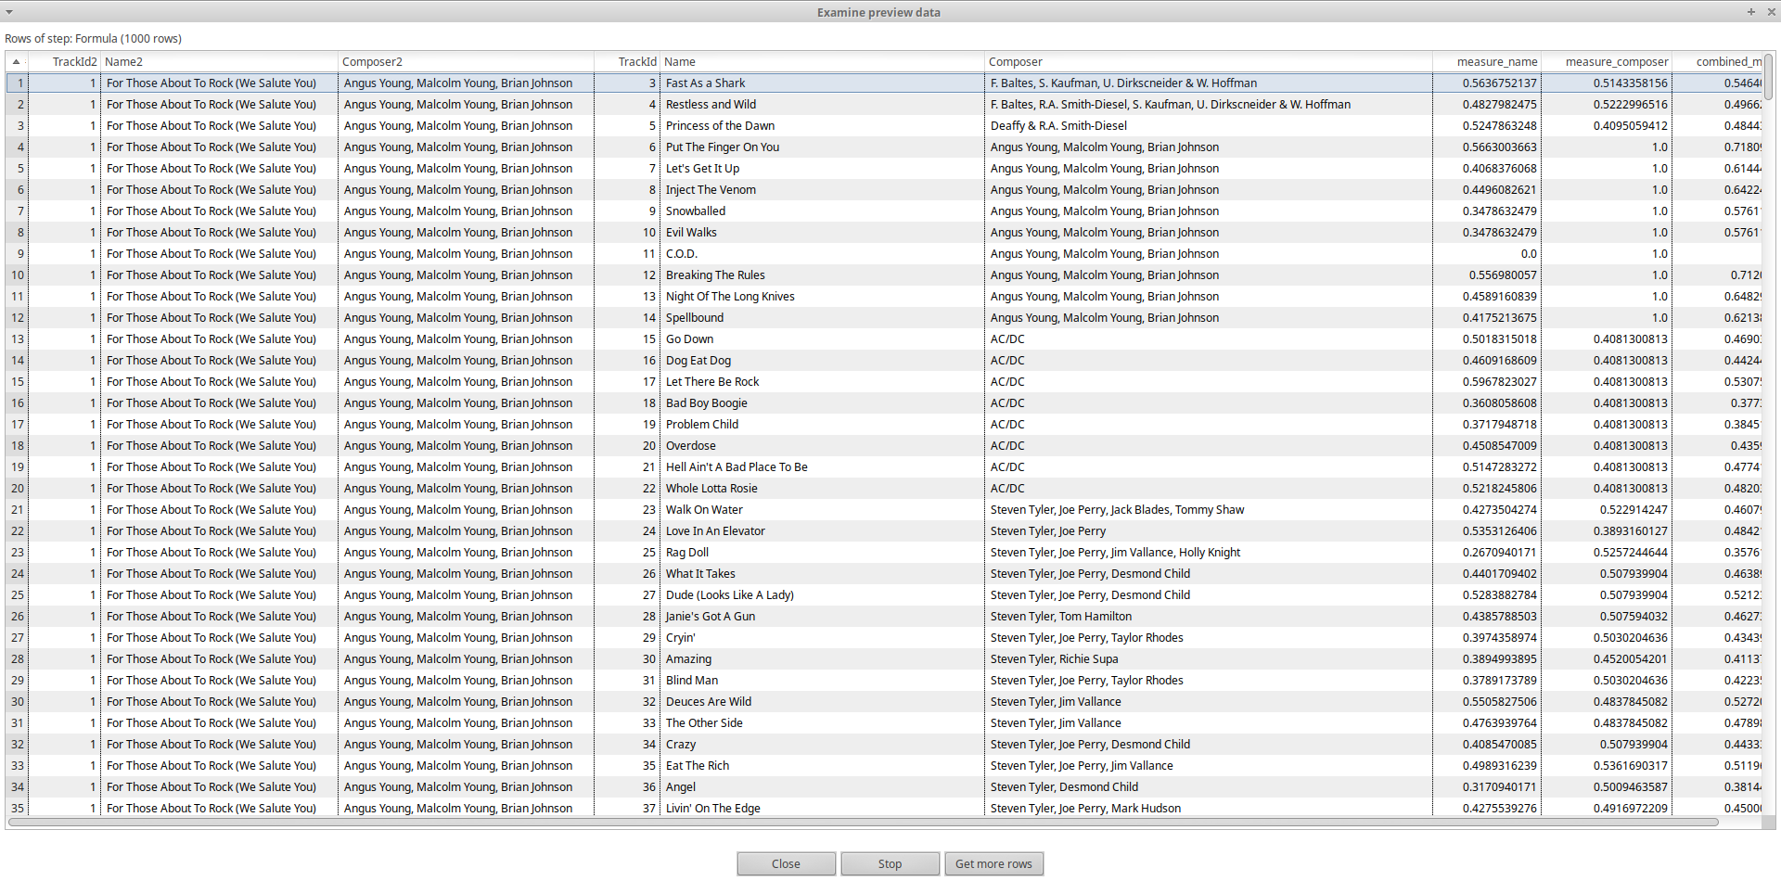
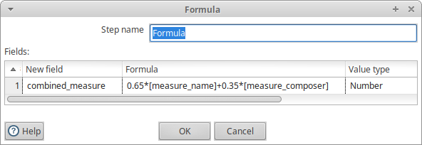
Formula

Slide 11
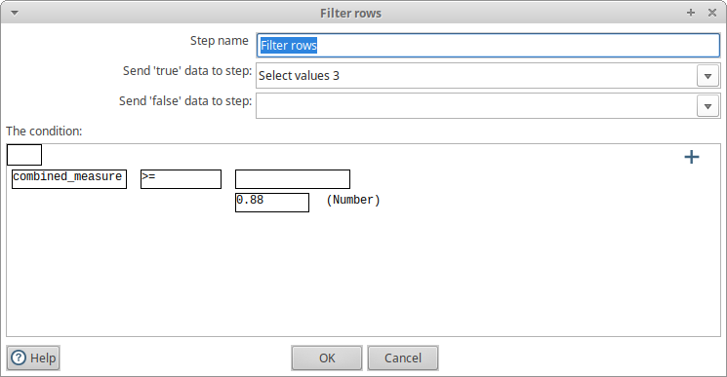
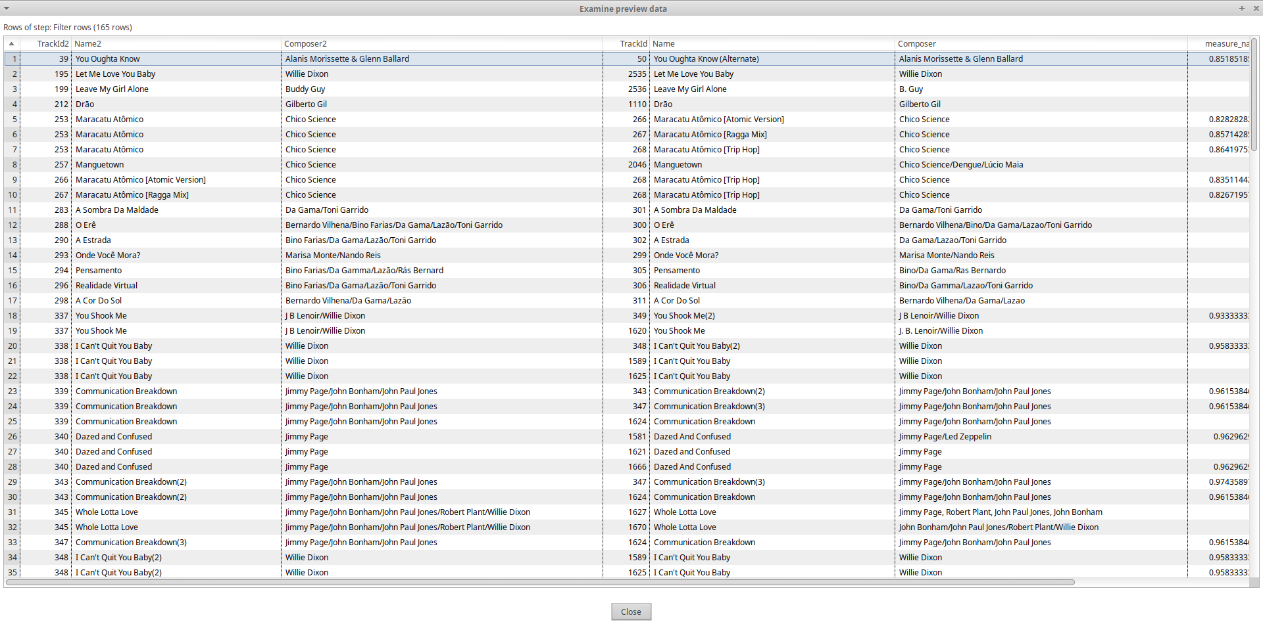
FILTER ROWS

Slide 12
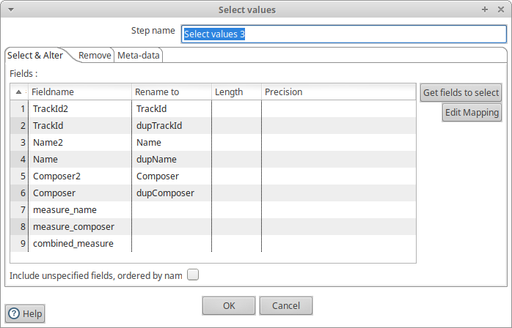
Select values (Select values 3)

Slide 13
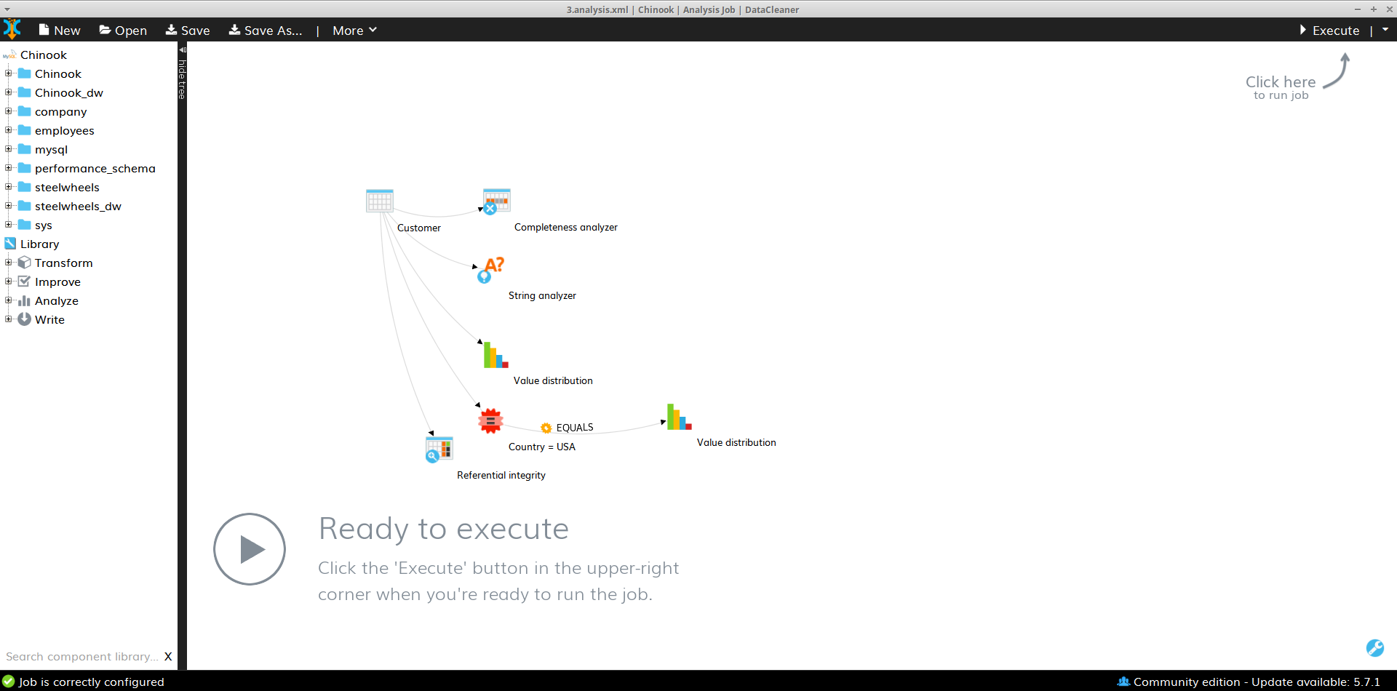
Challenge 3.

Slide 14
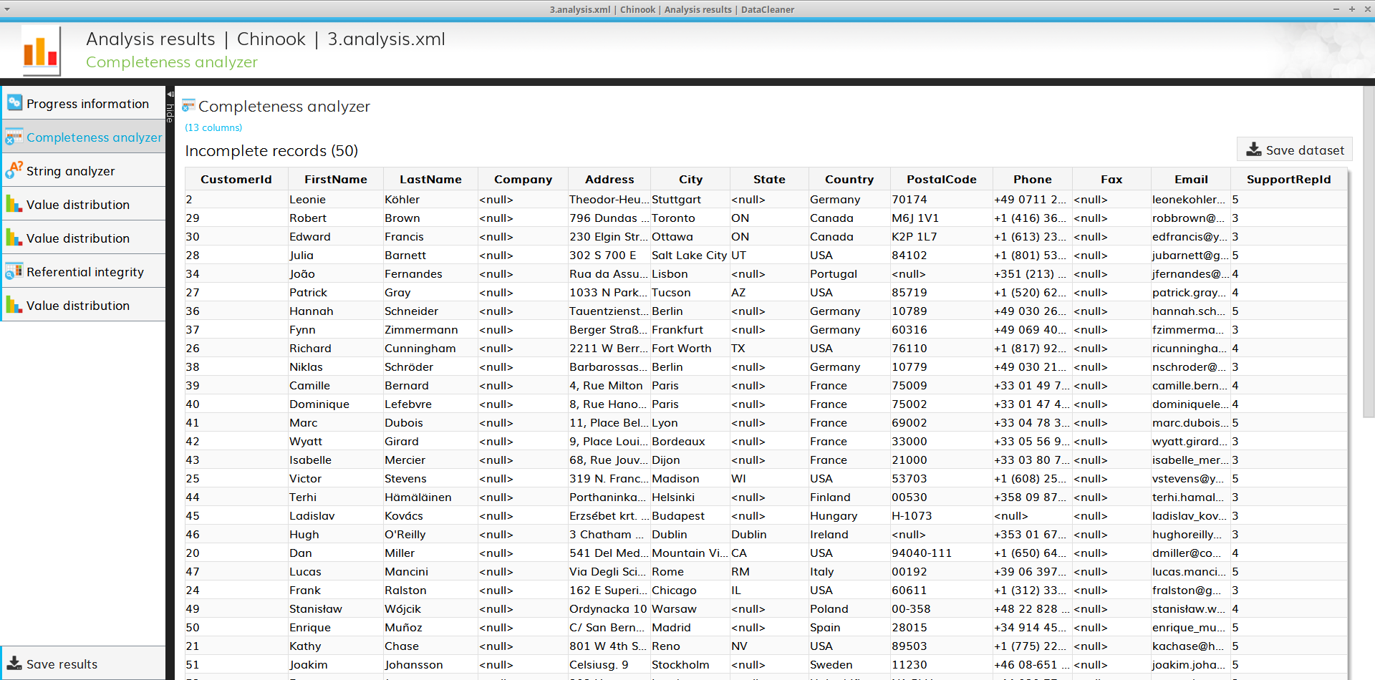
Completeness Analyzer
There are 50 records with missing information
Most of them are missing ‘State’ which is normal since there are a lot of countries not divided into states
Most of the records with missing values have no ‘Fax’ associated

Slide 15
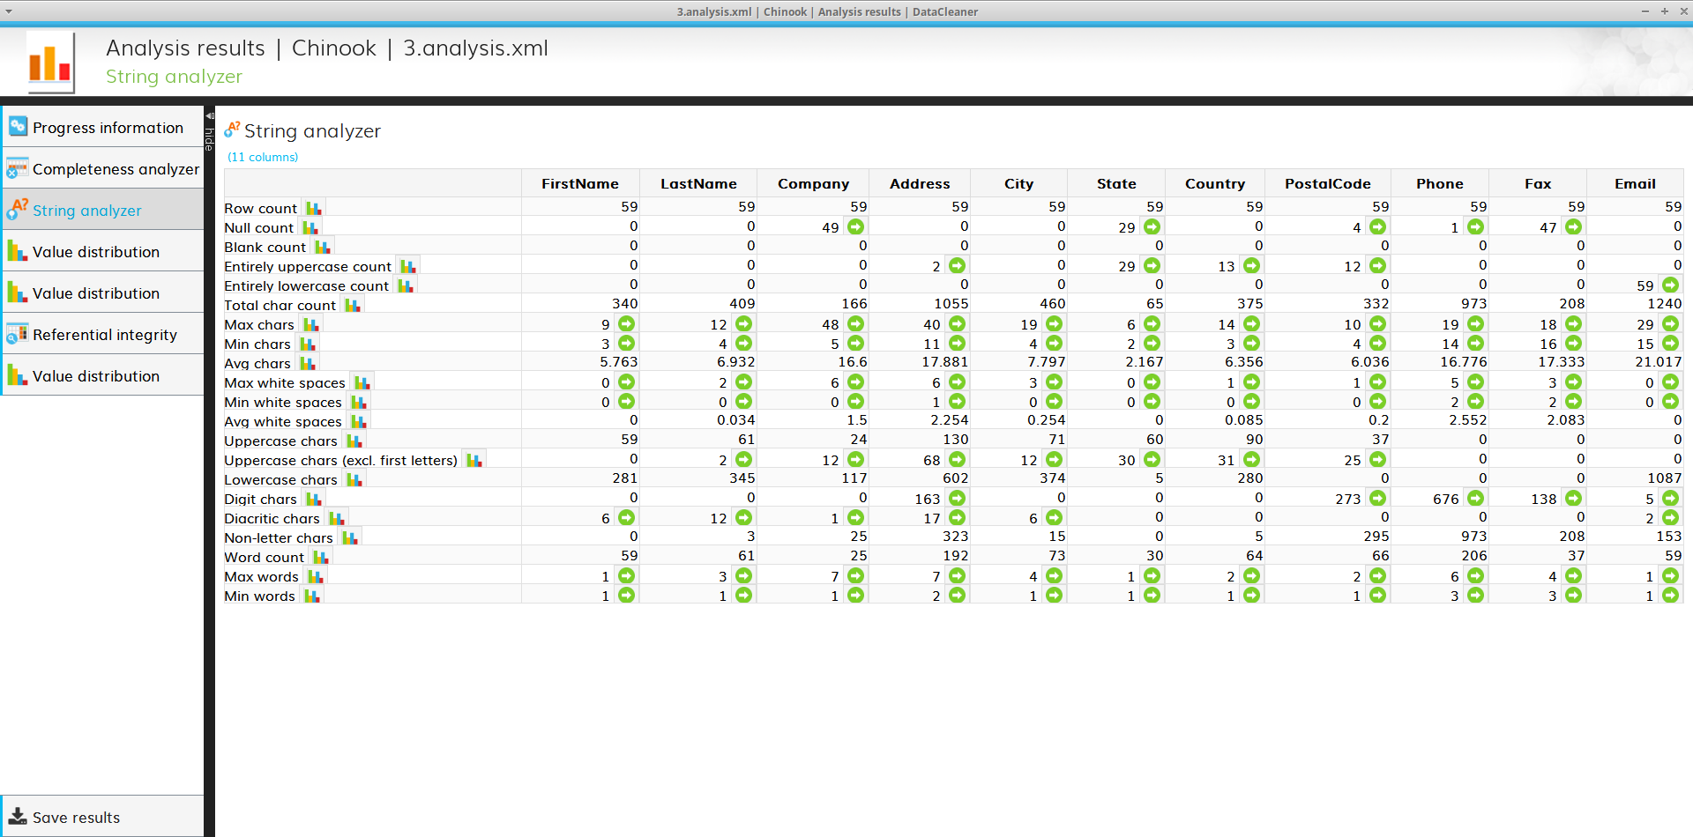
String Analyzer
The postal code field is composed almost entirely of numbers, with some uppercase letters.
A few records have a LastName with white spaces.
As expected, all records only have digits in the Phone and Fax fields.

Slide 16
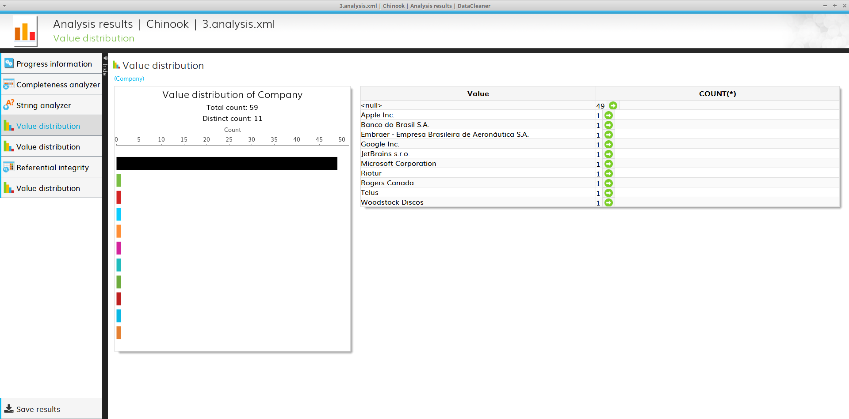
Value Distribution
Most of the customer records have no company associated (null)
All the companies associated with customers appear exactly 1 time

Slide 17
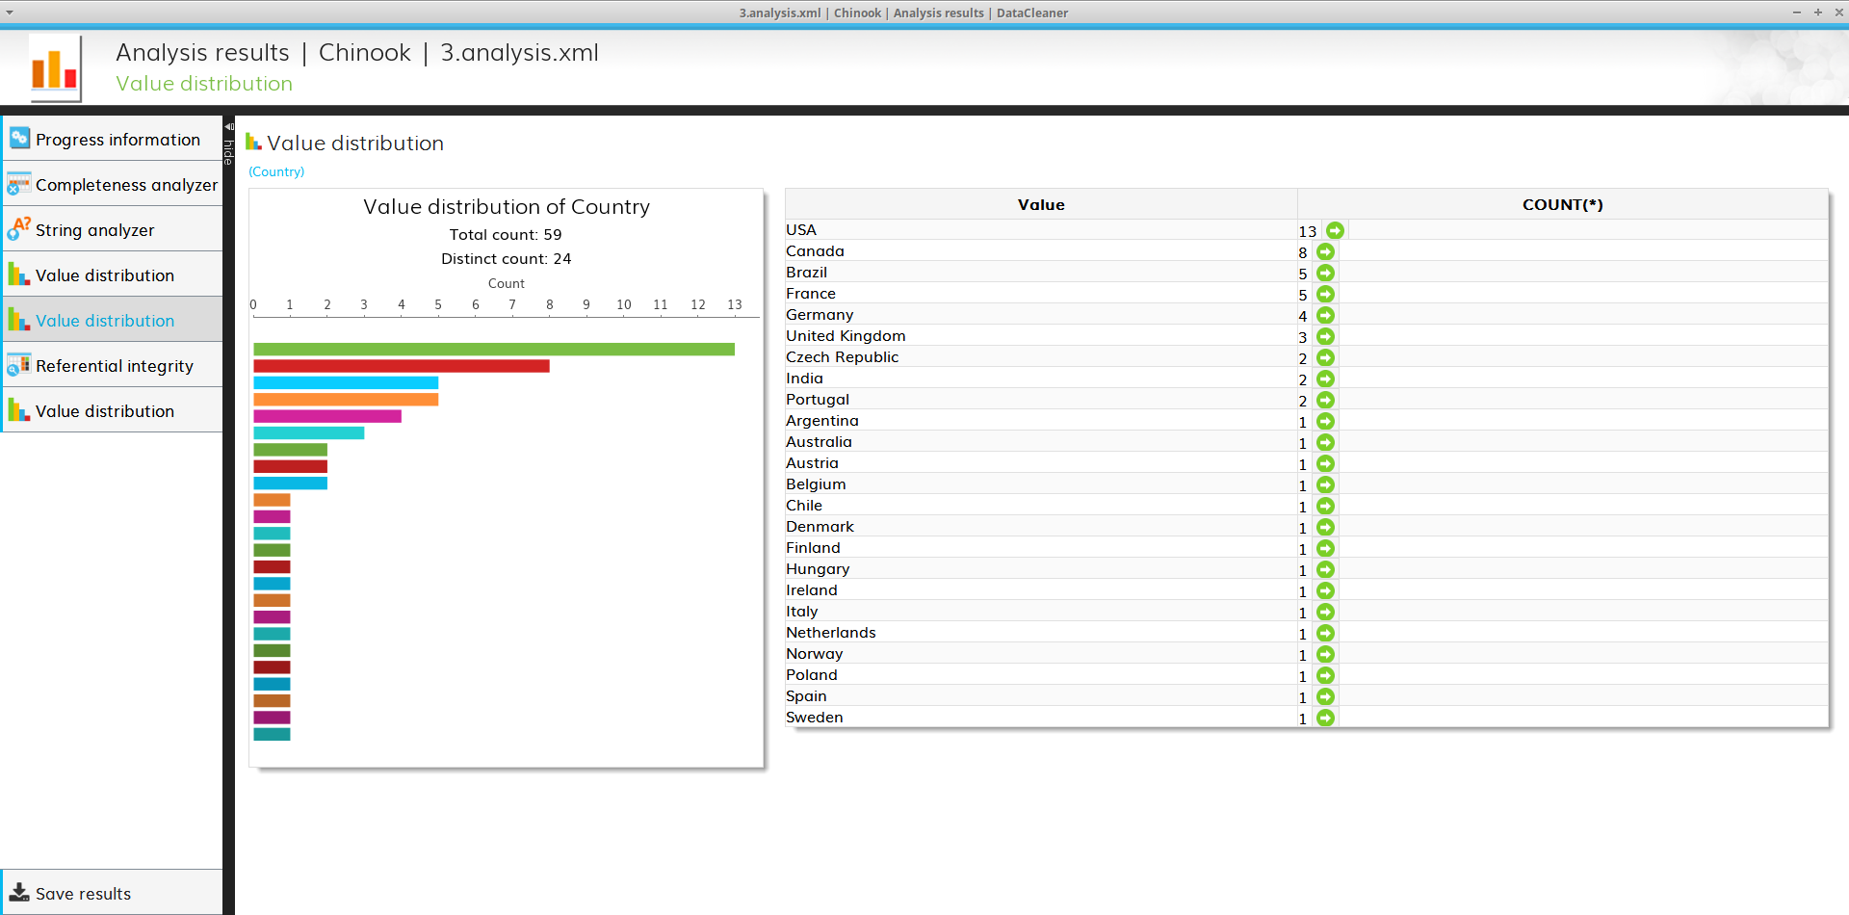
Value Distribution
Most records are from American countries
Only two records are from the continent of Asia, namely from India.

Slide 18
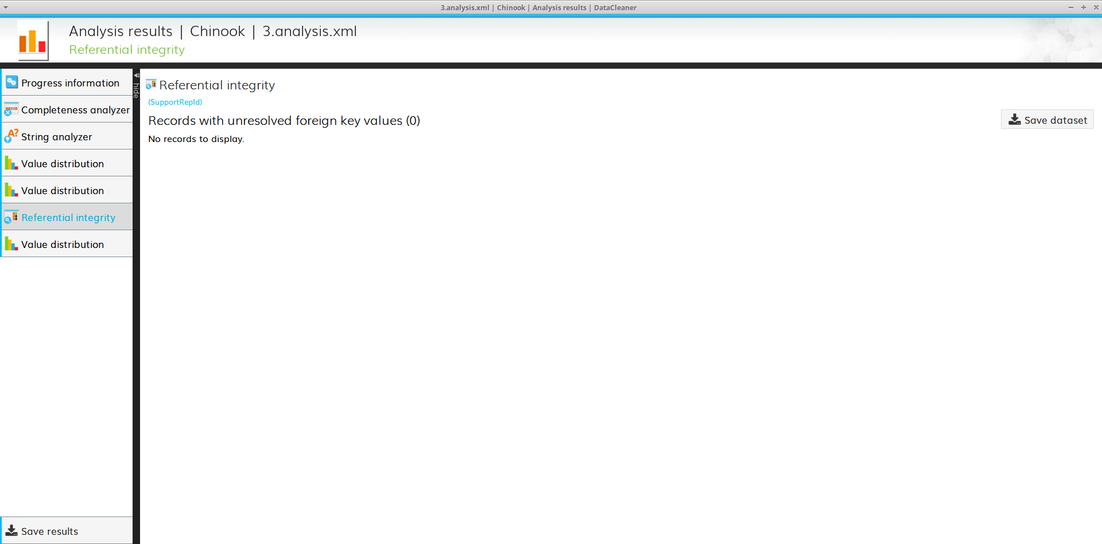
Referential Integrity
All the customer records have a valid value stored in ‘SupportRepId’ (references the Employee Table)

Slide 19
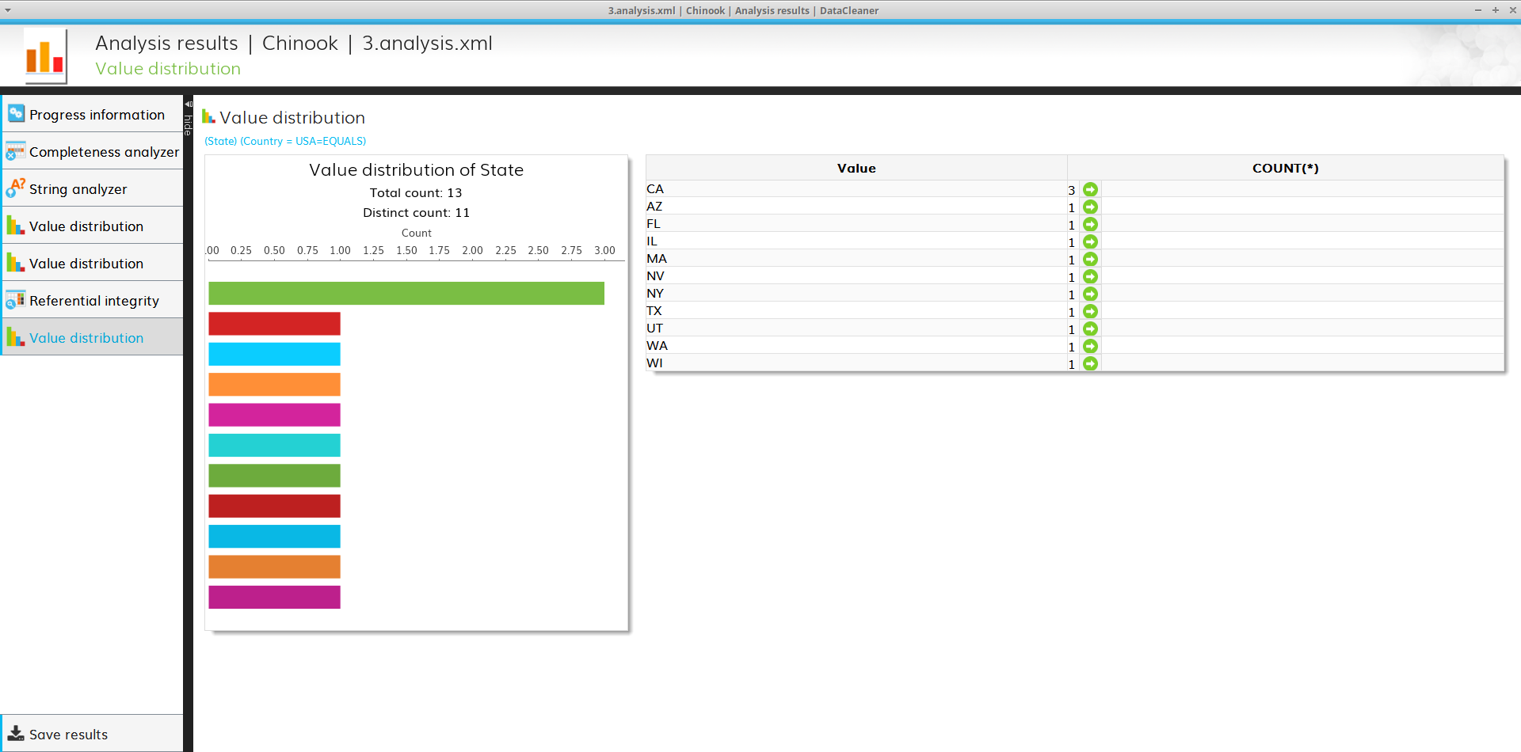
Value Distribution
Only one state is part of more than one record (CA – California)

Slide 20
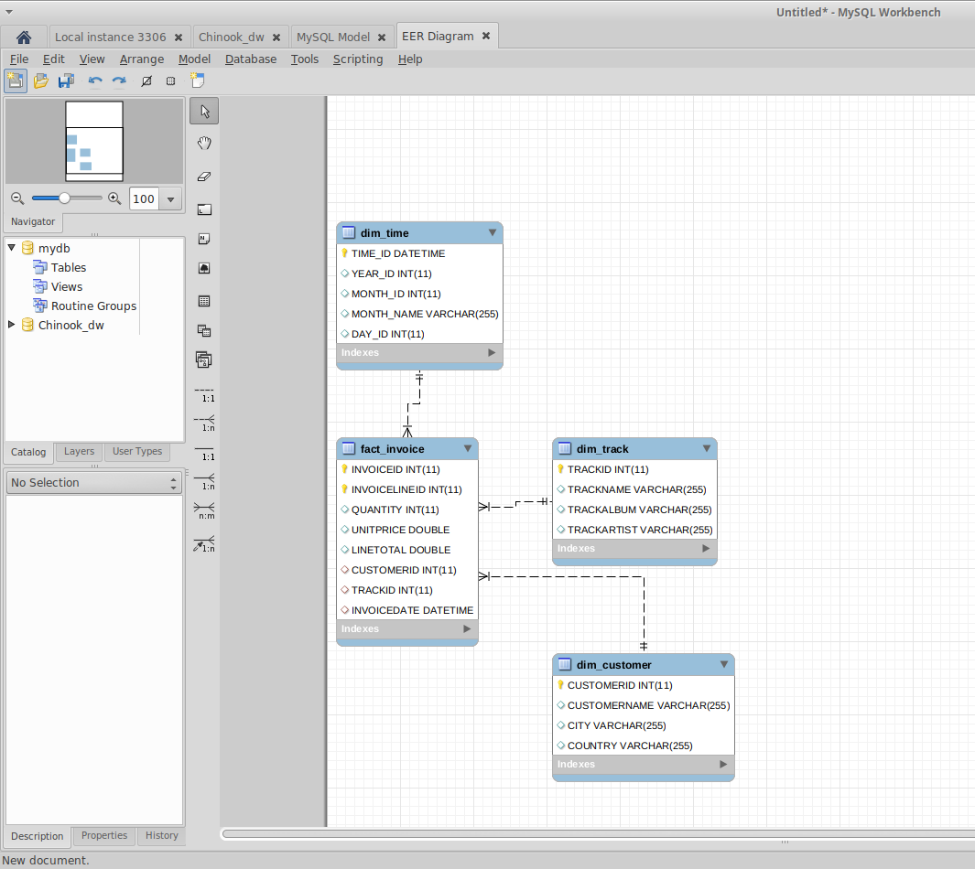
Challenge 4.

Slide 21
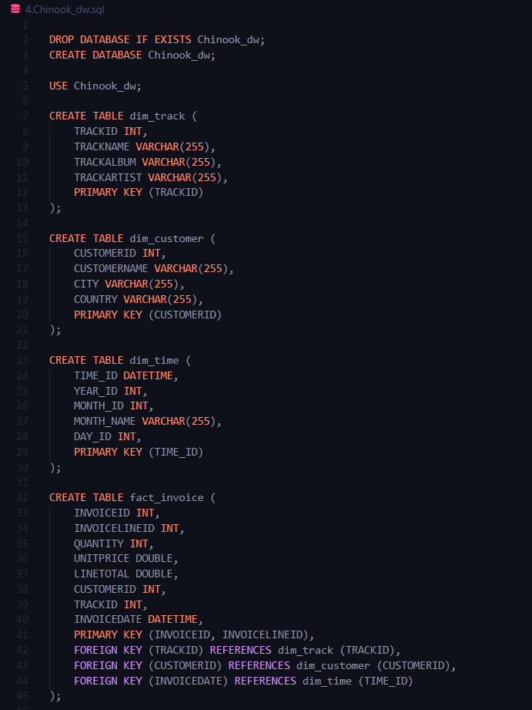
Code used to implement Chinook_dw

Slide 22
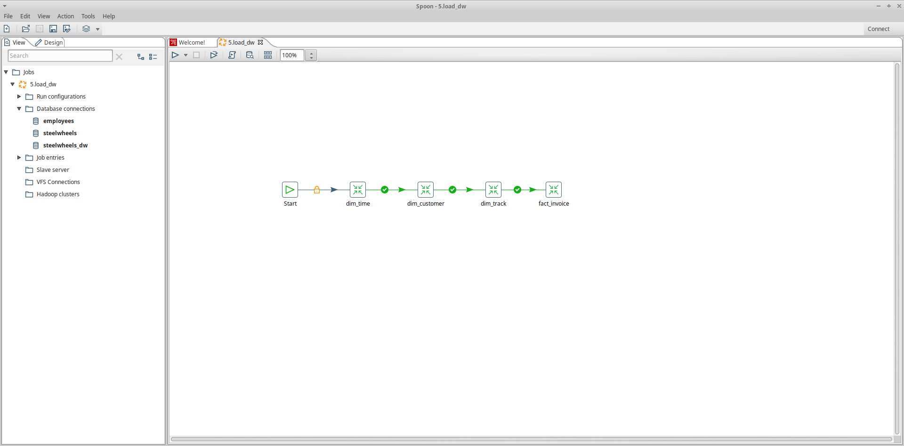
Challenge 5.

Slide 23
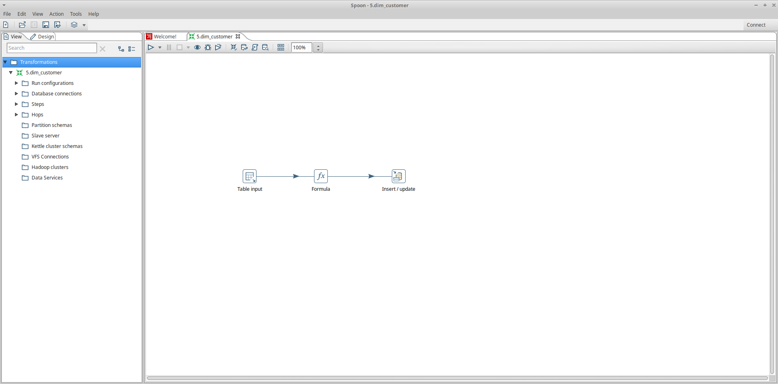
Dim Customer

Slide 24
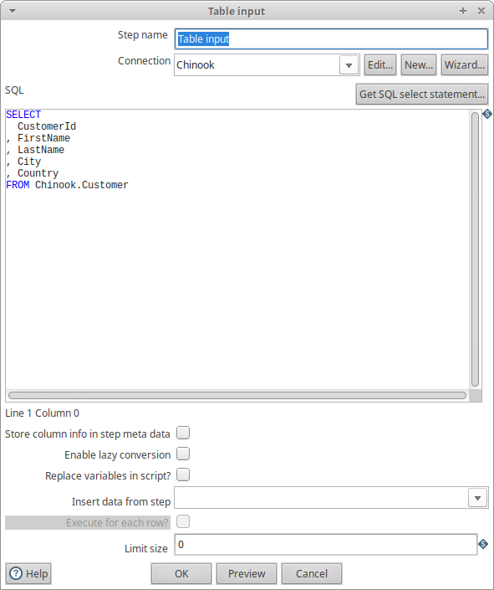
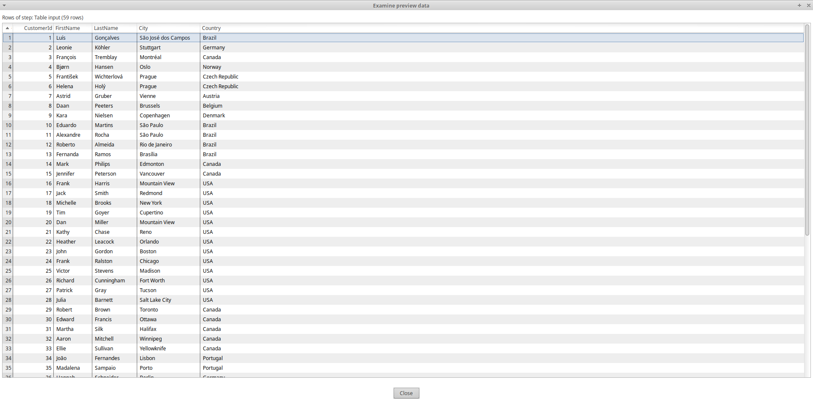
Table input

Slide 25
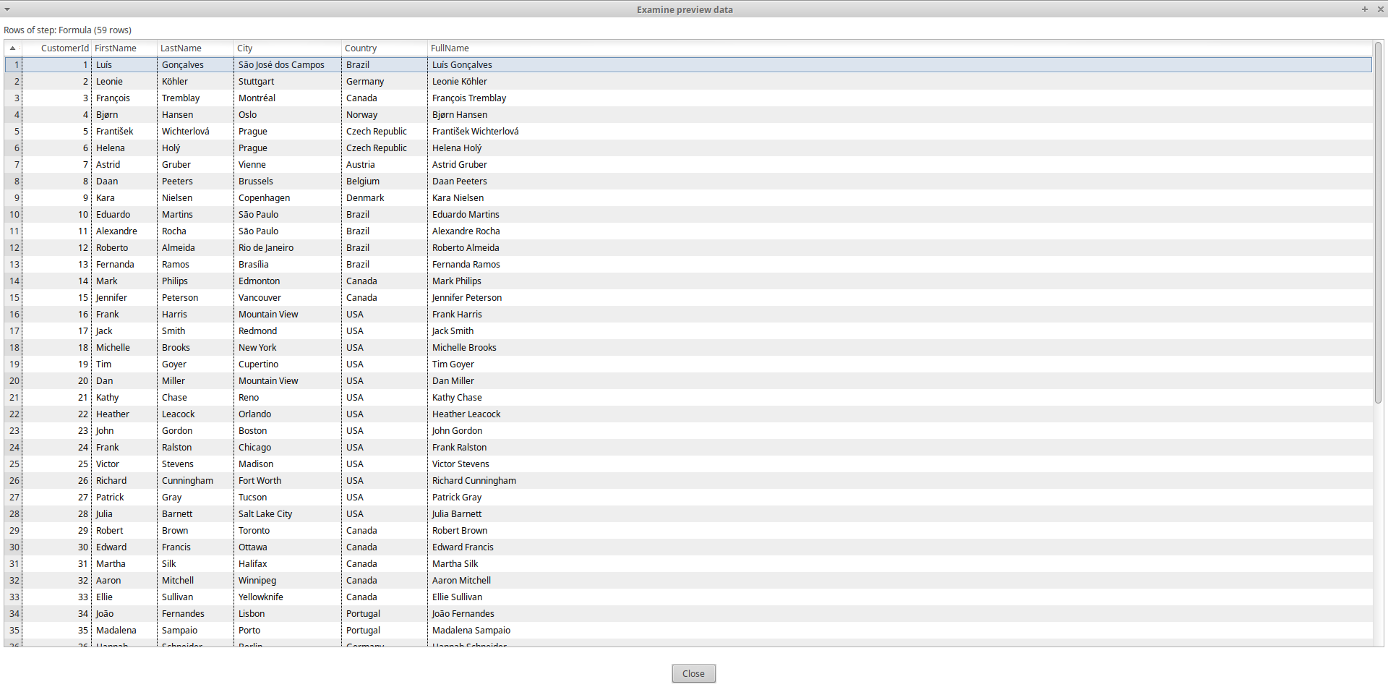
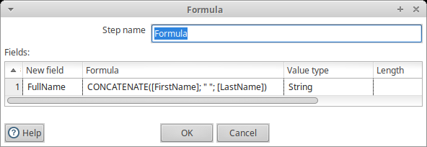
formula

Slide 26
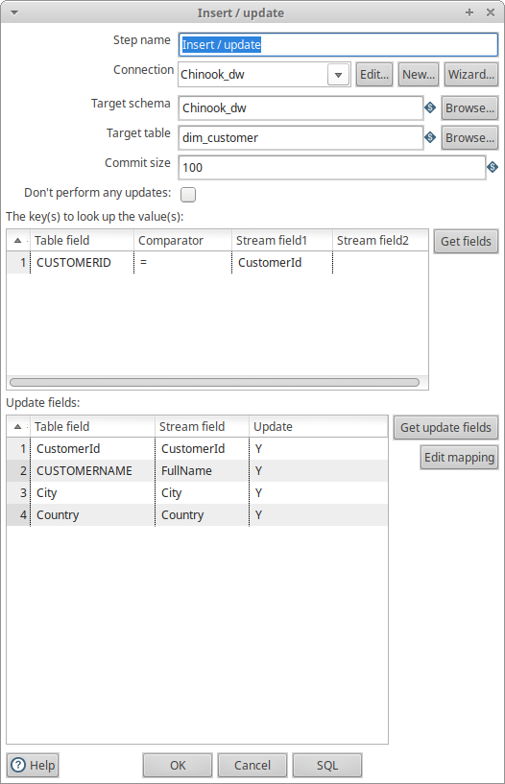

INSERT / UPDATE

Slide 27
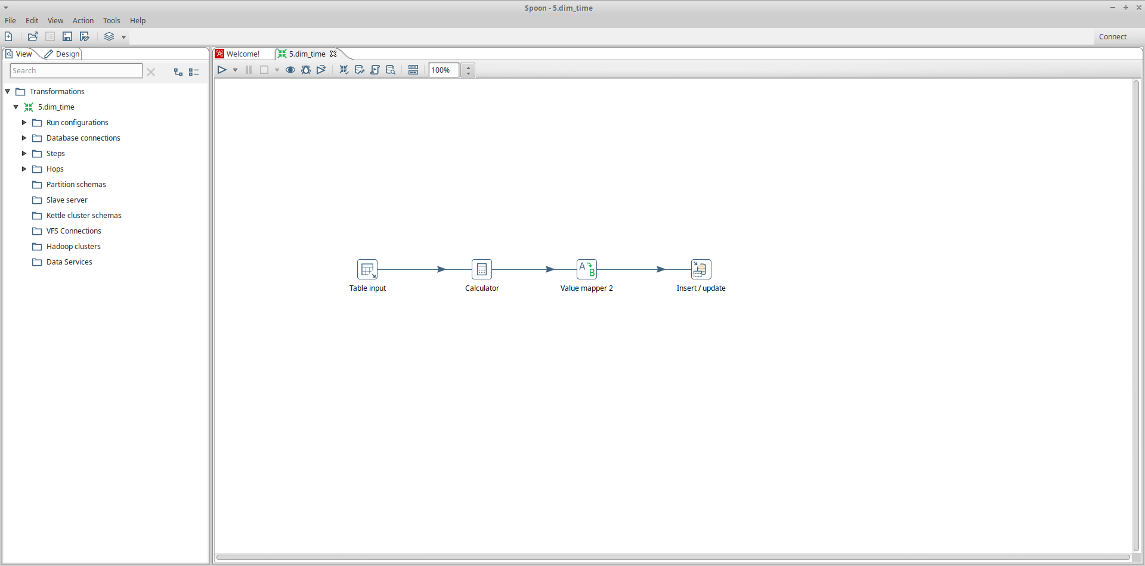
Dim time

Slide 28
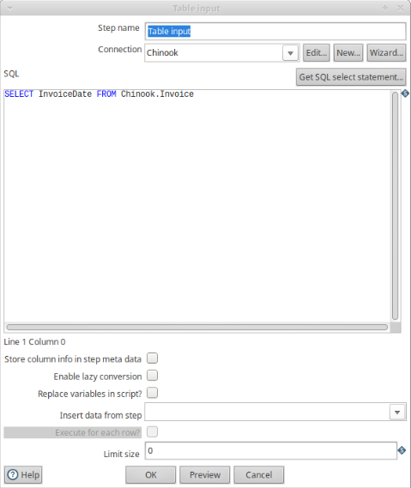
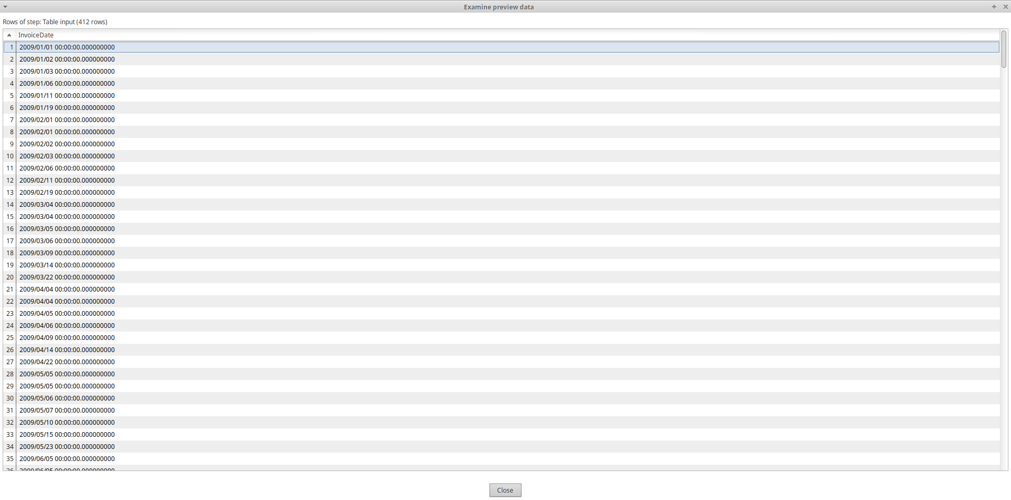
Table input

Slide 29
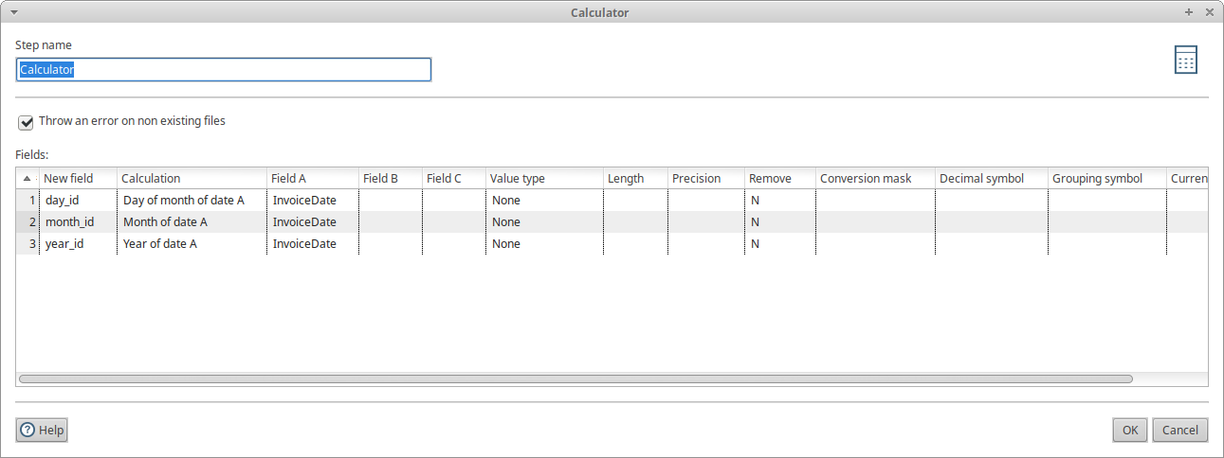
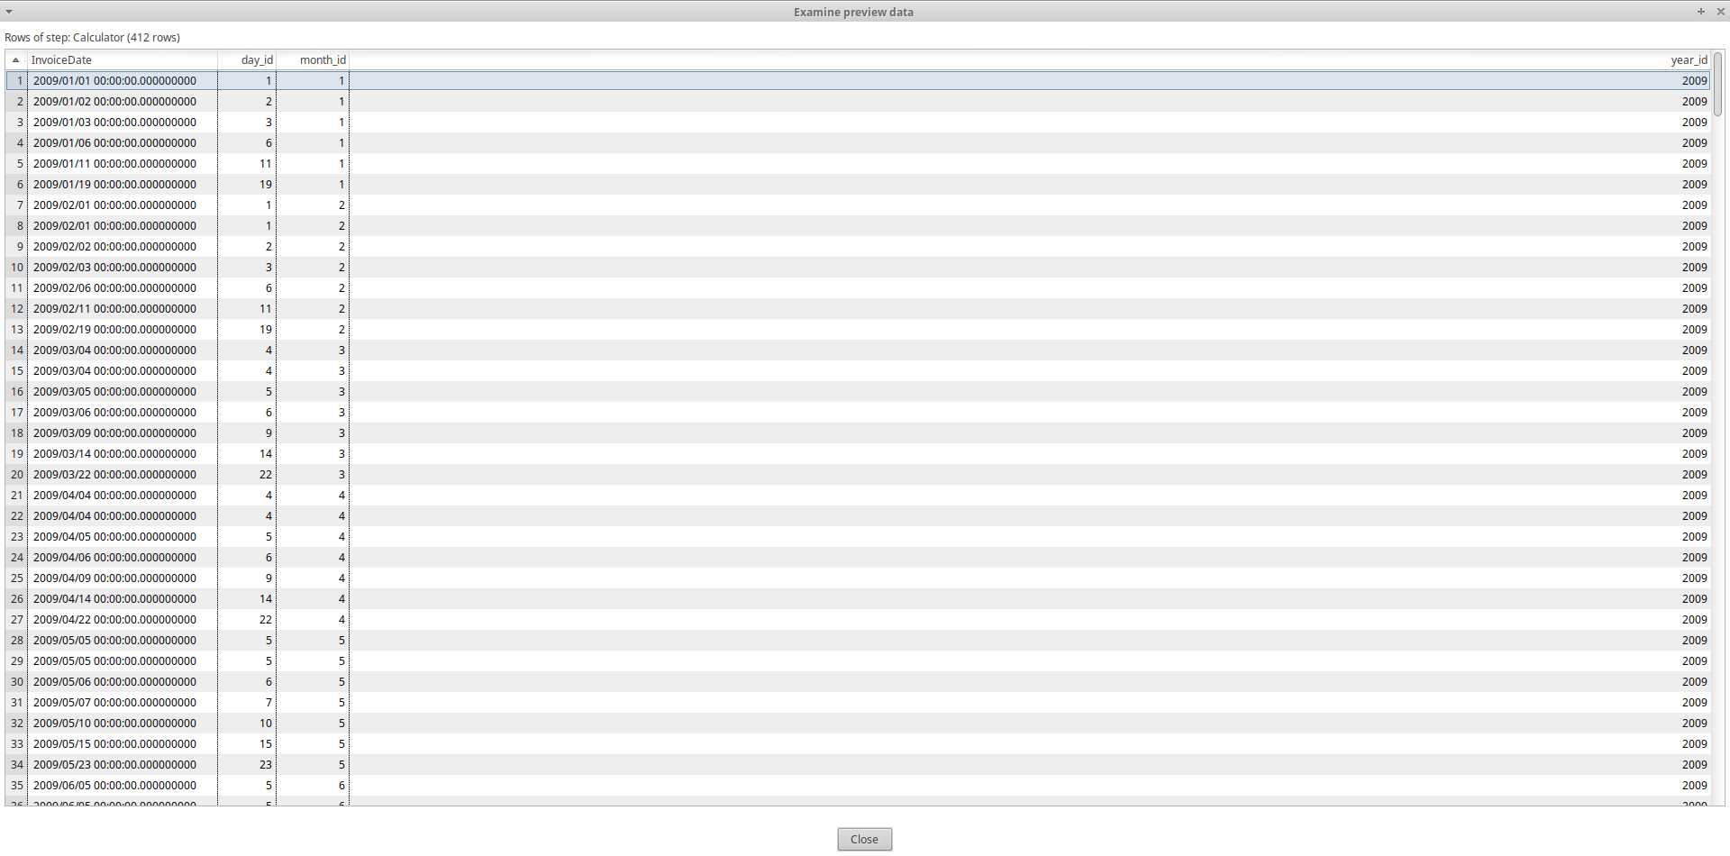
Calculator

Slide 30
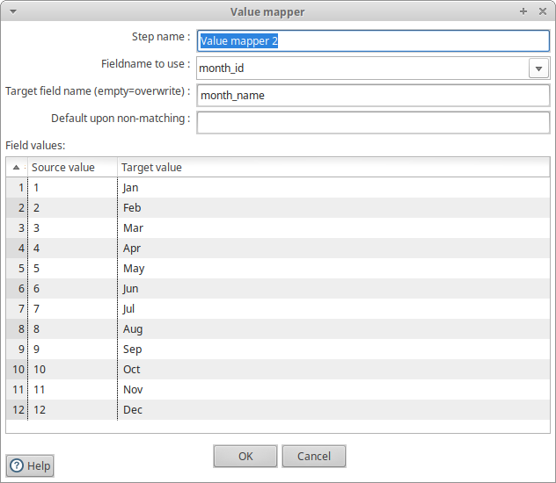
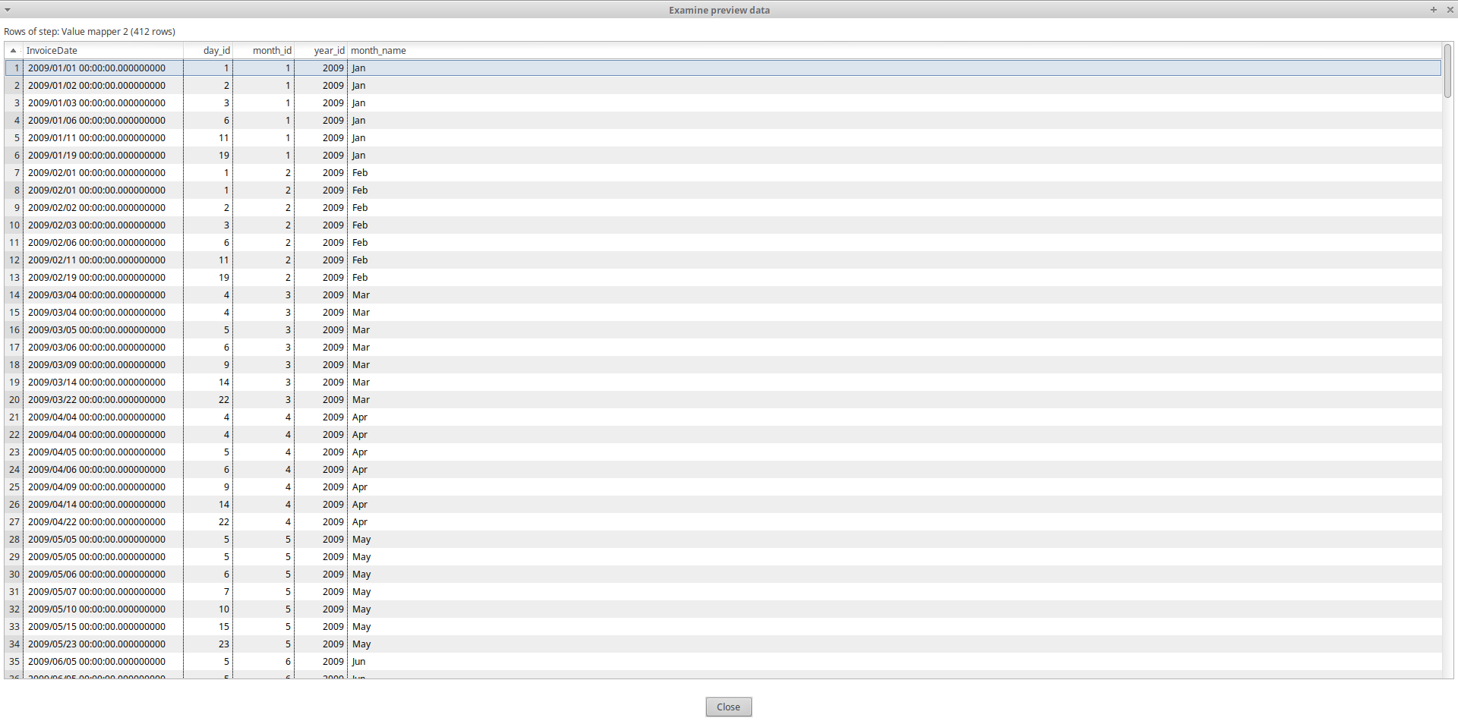
Value Mapper

Slide 31
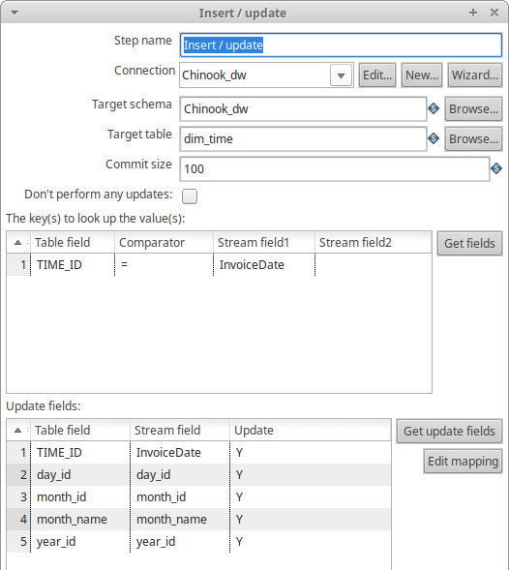

Insert / update

Slide 32
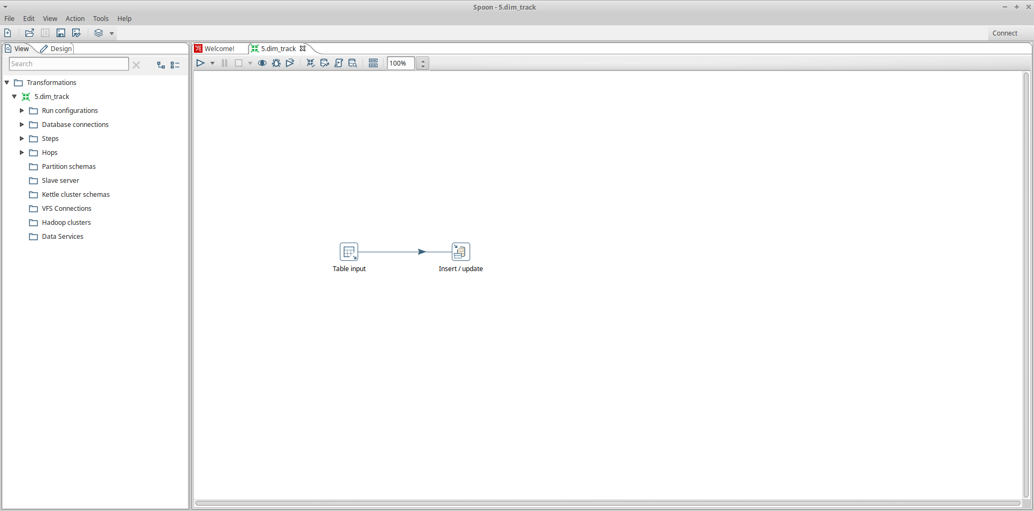
Dim track

Slide 33
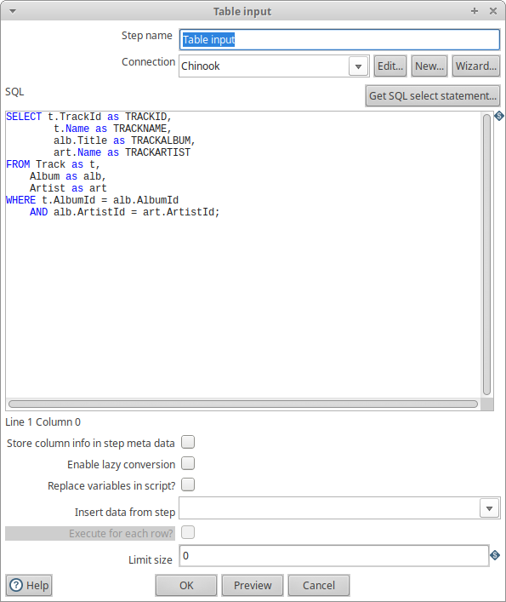
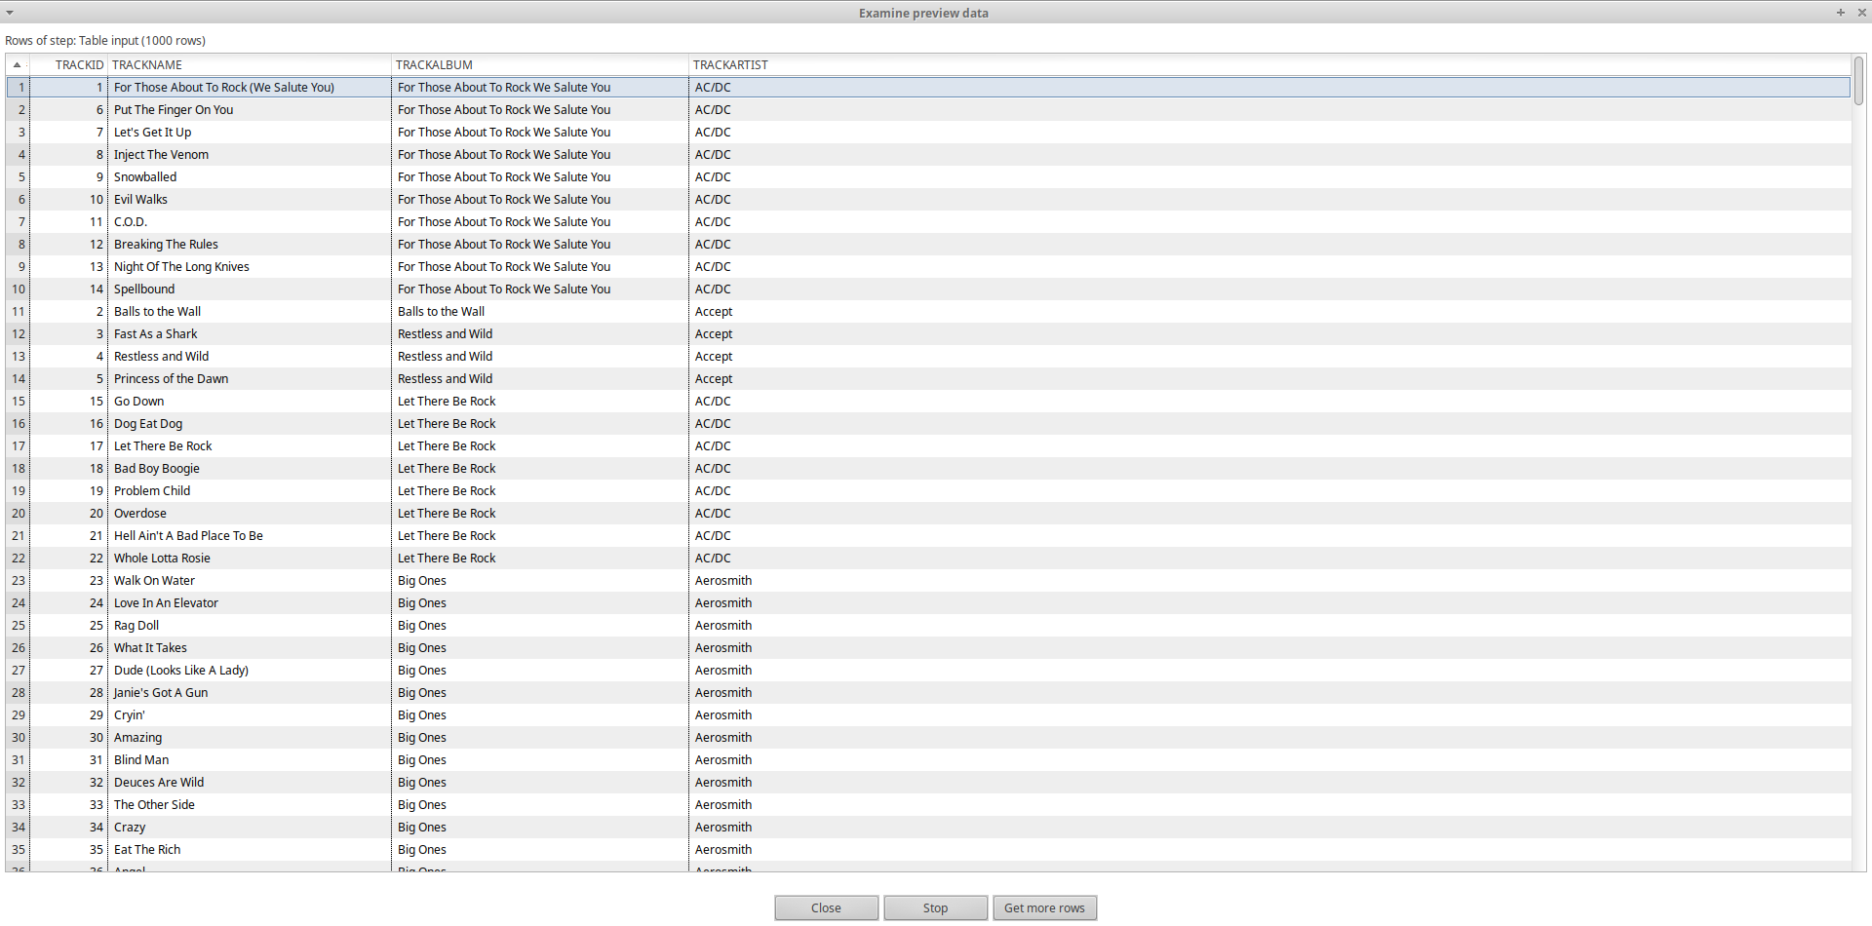
Table input

Slide 34
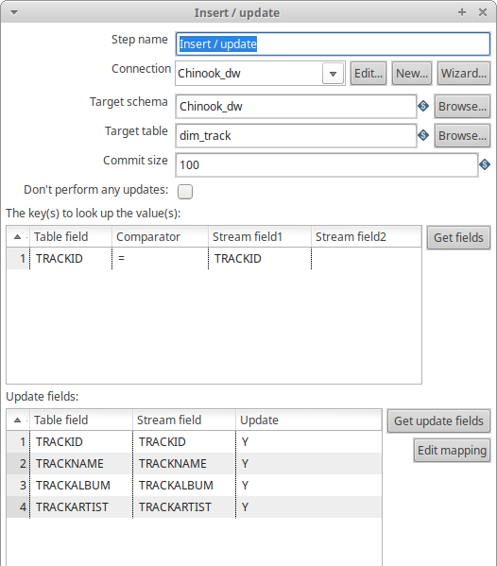

Insert / Update

Slide 35
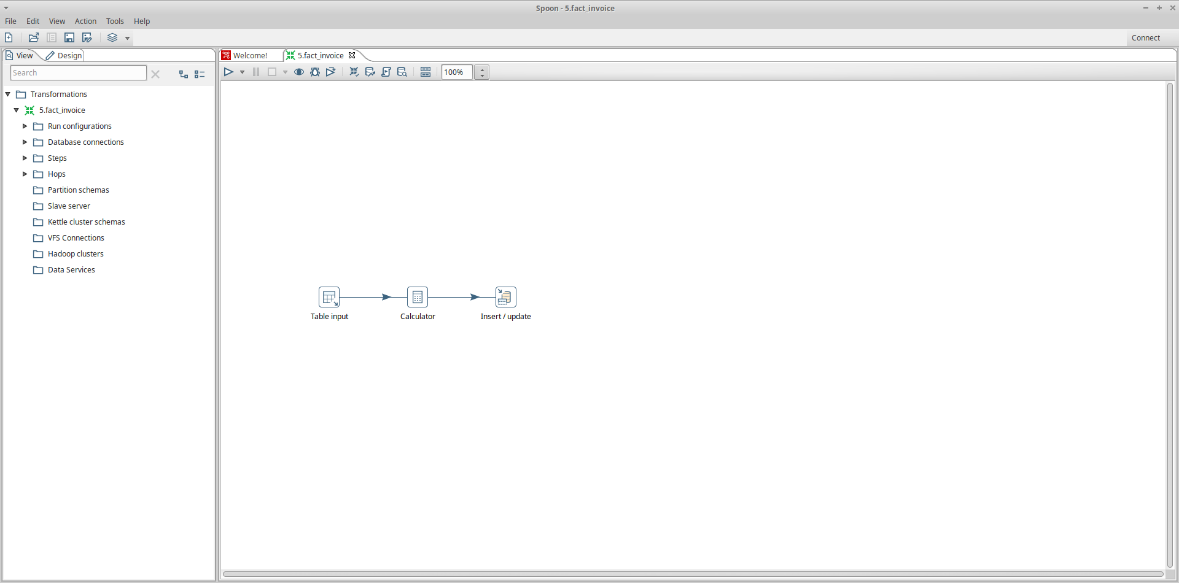
Fact invoice

Slide 36
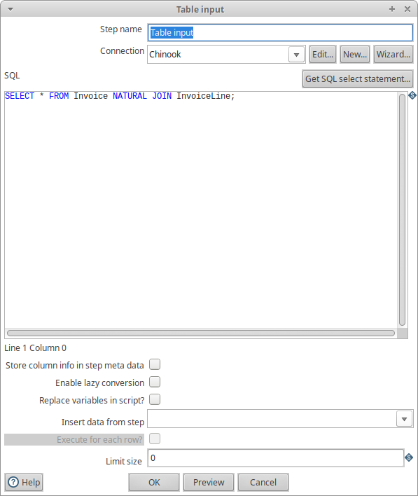
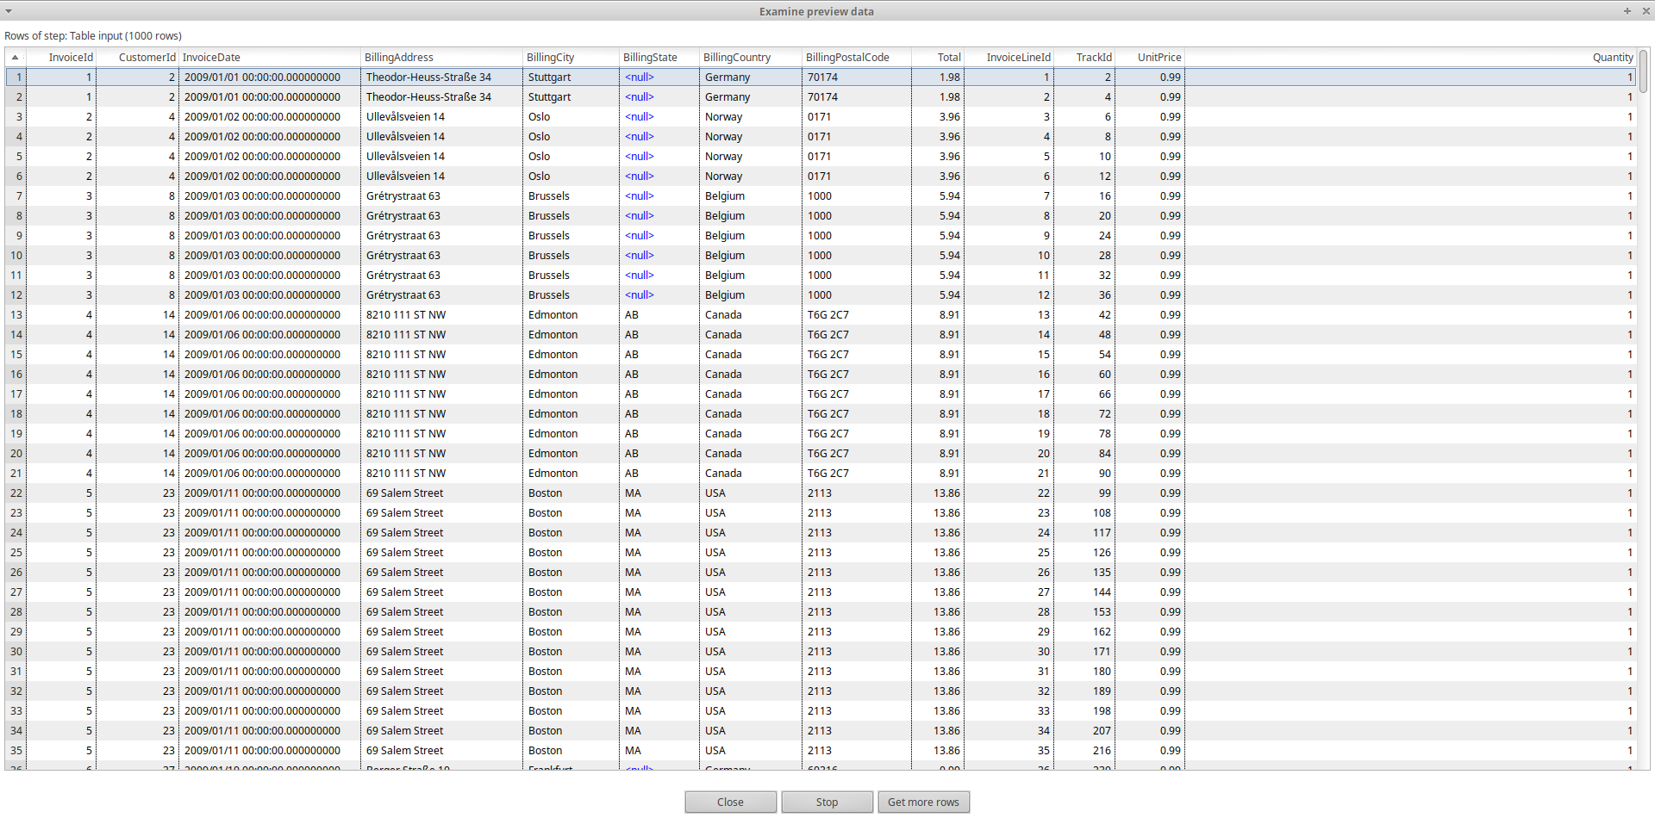
Table input

Slide 37

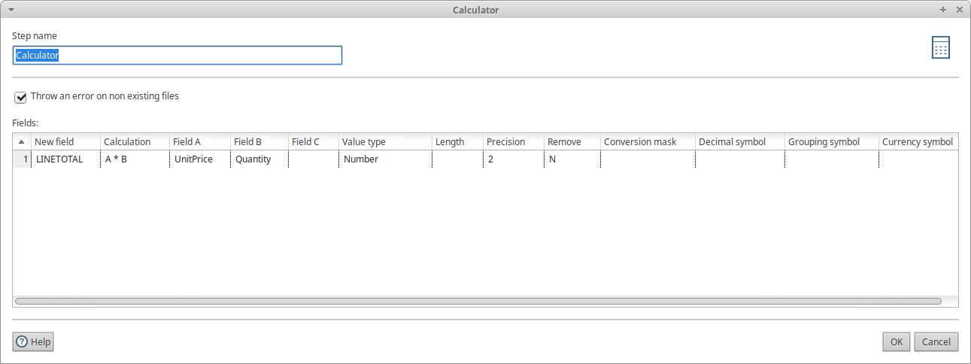
Calculator

Slide 38


INSERT / UPDATE

Slide 39

Challenge 6. Query 1

Slide 40

Challenge 6. Query 1
Summing Sales grouped by Artist and Year
Gives a perspective of how big the sales were for each Artist by Year
Allows a comparison between Artists and Years

Slide 41

Challenge 6. Query 2

Slide 42

Challenge 6. Query 2
Counting Units sold by Album and Country
Counts how many copies were sold of each album in each country
Allows the comparison of how well was each album in each country

Slide 43

Challenge 7.

Slide 44

Challenge 8. Query 1

Slide 45

Challenge 8. Query 2

Slide 46


Challenge 9. Query 1

Slide 47


Challenge 9. Query 2

Slide 48

Challenge 11. Proof of execution

Slide 49

Chinook_dw SQL

Slide 50

Dim_customer

Slide 51


Dimensional Lookup / Update
The primary key of dim_customer was changed to CustomerCode
CustomerID represents the person but CustomerCode represents the version
If there is an update to CustomerName, City or / and Country a new Version is created

Slide 52

Fact_invoice

Slide 53

Database Lookup
We search in table dim_customer for the records with the same CustomerID as the one in the fact, and with the current date between the DateFrom and DateTo
Our field of interest is CustomerCode, this is the primarykey of dim_customer

Slide 54

Insert / Update
We changed the Update fields instead of storing the CustomerID we store the CustomerCode

